Slide 1
Lecture 04: File Systems and Directories
Notes:
‹#›
8/22/2012
Defense
Christo Wilson

Slide 2
Introduction to UNIX File System
Hierarchical arrangement of directories and files
Files are stored in a tree structure (folders inside folders).
The topmost folder is called the root directory /.
Each file or directory has details called attributes:
Directories contain entries with filenames and attributes
Attributes: type, size, owner, permissions, last modified
'stat' and 'fstat' functions retrieve file attributes.

Slide 3
Types of Files
1. Regular File - Contains data (text or binary)
2. Directory File - Contains names and pointers to files
3. Block Special File - Buffered I/O in fixed-size units to devices
4. Character Special File - Unbuffered I/O in variable-size units to devices
5. FIFO (Named Pipe) - Communication between processes
6. Socket - Network/non-network communication between processes
7. Symbolic Link - Points to another file

Slide 4
Virtual File System Switch
Supplies applications with the system calls for file system management.
Problem: Different File Systems, Different Rules
Computers can use many types of file systems: ext2, NTFS, FAT32, procfs, etc.
Each has its own way of storing and retrieving data. Without a common layer, every program would need to know all of these formats, which is very messy.
The Virtual File System (VFS) is like a universal translator between programs and all the different file systems.
Applications use the same commands (open, read, write)
VFS figures out which file system is in use and talks to it in its “native language”
Specific focus on ext2fs and procfs of Unix.
Different types of files are possible:regular files,directories,device files,fifo’s,pipes,symbolic links,sockets.
Meta data information kept separately.”inodes” are used for describing files.

Slide 5
File Type Macros (<sys/stat.h>)
In C programming, a macro is like a shortcut name that gets replaced with some code before the program runs.
These macros come from the header file <sys/stat.h> and are used to check what type a file is.
When we write a C program, we might need to know:
Is this file a directory?
Is it a normal file?
Is it a device?
The OS stores this information in the file’s metadata.
We can ask for this metadata with the stat() function, then check the file type with these macros.

Slide 6
S_ISREG() - Regular file - .txt, .c, .jpg
S_ISDIR() - Directory file - Documents/
S_ISCHR() - Character special file - /dev/tty
S_ISBLK() - Block special file - /dev/sda
S_ISFIFO() - FIFO or pipe - /tmp/myfifo
S_ISLNK() - Symbolic link - shortcut to another file
S_ISSOCK() - Socket - /var/run/docker.sock

Slide 7
IPC Type Macros (<sys/stat.h>)
IPC = Inter-Process Communication — a way for different programs (processes) to talk to each other.
In UNIX, some IPC mechanisms are represented like files — so you can use similar commands to check or manage them.
Just like we used S_ISREG() to check if something is a regular file, IPC type macros check if a file is actually:
A Message Queue → passes messages between processes in order
A Semaphore → used for locking, to control access to resources
A Shared Memory Object → memory space that multiple processes can read/write
Not all UNIX systems treat these IPC objects as files — so these macros may not work everywhere.
This is specific to POSIX.1 systems where IPC objects can appear in the filesystem (like in /dev/mqueue or /dev/shm).

Slide 8
• POSIX.1 allows IPC objects as files
• Macros use pointer to 'stat' structure:
- S_TYPEISMQ() - Message queue
- S_TYPEISSEM() - Semaphore
- S_TYPEISSHM() - Shared memory object
• Not all UNIX implementations represent these as files

Slide 9
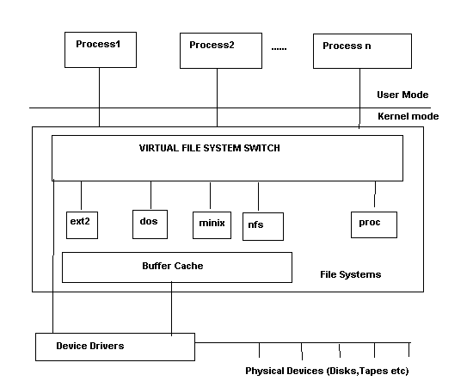
Virtual File System Switch

Slide 10
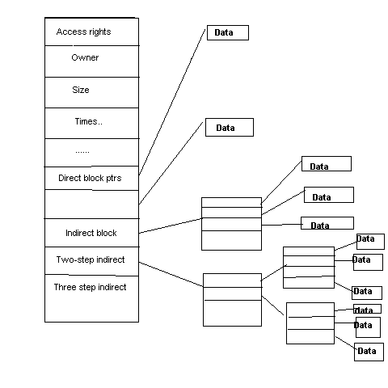
Structure of Inode

Slide 11
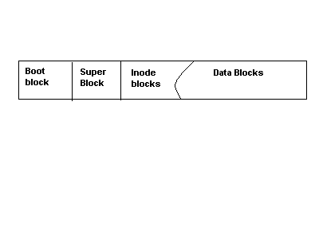
Unix File System

Slide 12
FEATURES OF UNIX FILE SYSTEMS
Boot Block : Will it always be present?
SuperBlock:Information for managing file systems
InodeBlocks:inode structures for the file system.
DataBlocks:blocks for files,directories..etc
Mounting,Unmounting file systems

Slide 13



Directories
Traditionally, file systems have used a hierarchical, tree-structured namespace
Directories are objects that contain other objects
i.e. a directory may (or may not) have children
Files are leaves in the tree
By default, directories contain at least two entries
“..” points the the parents directory
“.” self pointer
.
..
/ (root)
bin
‹#›
python

Slide 14



More on Directories
Directories have associated meta-data
Name, number of entries
Created time, modified time, access time
Permissions (read/write), owner, and group
The file system must encode directories and store them on the disk
Typically, directories are stored as a special type of file
File contains a list of entries inside the directory, plus some meta-data for each entry
‹#›

Slide 15
Representation of File systems
Management structures for file systems is similar to logical structure of UNIX file system.
VFS responsible for calling file-system specific implementations. How does VFS know which filesystems are configured?
Void register_filesystem(struct file_system_type *);
Configured at boot-time and possibly loaded as modules as well.
struct file_system_type {
Const char *name;
Int fs_flags;
Struct super_block *(*read_super)(struct super_block*,void *,int);
#ifdef VERSION > 2.4
Struct module *owner;
Struct vfsmount *kern_mnt;
#endif
Struct file_system_type *next;
};
Notes:
‹#›
Functions are made known to the VFS via the function “register_filesystem”

Slide 16
Mounting
Mounting = making a file system accessible by attaching it to the main directory tree at a specific location (called a mount point).
Without mounting, the OS cannot see or access the files on that device.
What is mount_root()?
Special function used during system startup.
Mounts the root file system / so the OS can start using it.
Without this step, the OS wouldn’t even have a place to store logs, run programs, or read configs.
Before Mounting: After Mounting:
/ /
├── home/ ├── home/
├── bin/ ├── bin/
└── media/usb/ (empty) └── media/usb/
├── file1.txt
└── image.jpg
Notes:
‹#›
Sets up the first file system.called by system call setup() after all file systems have been registered.setup() is called after init is created.Why is a system call required here?User mode process.

Slide 17
Any file system in UNIX must be mounted before it can be accessed,either through mount() or mount_root().
What is mount_root() ?
Representation of a mounted file system : struct super_block.Limited to NR_SUPER.
It is initialized by the function “read_super” in the VFS.It interrogates floppy disks,CD-ROM for a change of media,tests if superblock is present and if so returns it.else it calls the fs-specific function to create a superblock.
File system specific Read_super() reads its data from the block device using the Unix cache functions,bread,brw_page.Processes may be put to sleep when reading/writing or mounting file systems.

Slide 18
Superblock
A superblock is a special data structure that holds information about the entire file system.
It’s like the table of contents for the disk — the OS uses it to understand how to read and manage files.
The OS cannot use the file system if the superblock is missing or corrupted.
ext2/ext4 keep backup copies of the superblock in different places so that if one is damaged, it can be restored.
In memory: struct super_block in the kernel represents a mounted file system.
On disk: Contains permanent info about the file system.
Key fields in struct super_block:
s_dev → Device identifier
s_blocksize → Block size in bytes
s_flags → File system state (read-only, dirty, etc.)
s_type → File system type (ext2, procfs, etc.)
s_mounted → Pointer to root inode
s_op → Pointer to superblock operations (functions for mounting, unmounting, syncing, etc.)

Slide 19
struct super_block {
kdev_t s_dev;/* device */
unsigned long s_blocksize;/* block size */
unsigned char s_blocksize_bits;/* ld(block size) */
unsigned char s_lock;/* superblock lock */
unsigned char s_rd_only;
Unsigned char s_dirt;
Struct file_system_type *s_type;
Struct super_operations *s_op;
Unsigned long s_flags;
Unsigned long s_magic;
Unsigned long s_time;
Struct inode *s_covered;/* mount point */
Struct inode *s_mounted; /* root inode */
Struct wait_queue *s_wait;/* s_lock wait queue */
Union {
Struct minix_sb_info minix_sb;
Struct ext2_sb_info ext2_sb;
….
Void *generic_sb;
}u;

Slide 20
Locking/Unlocking superblock
In a multitasking OS like UNIX, multiple processes (or threads inside the kernel) might try to read or modify the same superblock at the same time.
If two things change it at once, data can become corrupted.
Locking ensures that only one process can access/modify the superblock at a time.
WORKING: The kernel uses a flag inside struct super_block (e.g., s_lock) to mark whether it’s in use.
Locking:
If s_lock is already set → another process is using it → wait until it’s free.
If not set → set it to 1 and proceed.
Unlocking:
Set s_lock back to 0.
Wake up any processes waiting to use it.

Slide 21
Lock_super(struct super_block *sb)
{
If(sb->s_lock) __wait_on_super(sb);
Sb->s_lock=1;
}
unlock_super(struct super_block *sb)
{
sb->s_lock=0;
wake_up(&sb->s_wait);
}
The read_super( ) function in the file system specific implementation should also make the root inode available using the function iget( );

Slide 22
Superblock operations
s_op points to a vector of functions for accessing the file system.
struct super_operations {
void (*read_inode)(struct inode *);
Int (*notify_change)(struct inode *,struct iattr *);
Void (*write_inode)(struct inode *);
Void (*put_inode)(struct inode *);
Void (*put_super)(struct super_block *);
Void (*write_super)(struct super_block *);
Void (*statfs)(struct super_block *,struct statfs *);
Void (*remount_fs)(struct super_block *,int *,char *);
};
These functions serve to translate the specific representation of the superblock and inode on data media to their general form in memory and vice-versa.Does every file system have a superblock and inode?
Elaborating a little more…
Notes:
‹#›
Some of the operations listed in the superblock may be NULL in which case no action will take place.

Slide 23
Write_super(sb) : saves info on super block.Used in synchronising the device.dirty bit is set in buffer.
Put_super(sb) : Called when unmounting file systems.Releases super_block and buffers used.restores consistency if necessary.super_block structure can be reused.
Statfs(sb,statfsbuf) : fills the statfs structure with file system information.
Remount_fs(sb,flags,options) : new attributes for file system and restoring consistency.
Read_inode(inode) : fills in the inode structure.Marks different file types by using different inode_operations struct.for example
If(S_ISREG(inode->I_mode)
Inode->I_op=&ext2_file_inode_operations;
Else if(S_ISDIR(inode->I_mode)
Inode->I_op=&ext2_dir_inode_operations;
Else if(S_ISLNK(inode->I-mode)
Inode->I_op=&ext2_symlink_inode_operations;
…….Similiarly for character devices,block devices,fifos,etc

Slide 24
Notify_change(inode,attr) : changes made to inode are acknowledged by this function.It is of interest only in NFS/Coda etc.Why?Each file on such a system has a local and a remote inode.The remote file system is informed of the change using iattr.
Write_inode(inode) : saves inode structure.
Put_inode(inode) : if inode is no longer required.Called when deleting file and release its blocks.

Slide 25
INODE
Struct inode {
Kdev_t I_dev;
Unsigned long I_ino;
Umode_t I_mode;
Nlink_t I_nlinkl;
Uid,gid etc….
Dev_t I_rdev; /* only if device special file */
Offset,times of modification,access,creation etc
Struct semaphore *I_sem;
Struct inode_operations *I_op;
Struct super_block *I_sb;
Struct wait_queue (I_wait;
Struct file_lock *I_flock;
Struct vm_area_struct *I_mmap;
Struct inode *I_next,*I_prev;
Struct inode *I_hash_next,*I_hash_prev;
Struct inode *I_boundto;

Slide 26
ext2 inodes
Size (bytes) | Name | What is this field for?
2 | mode | Read/write/execute?
2 | uid | User ID of the file owner
4 | size | Size of the file in bytes
4 | time | Last access time
4 | ctime | Creation time
4 | mtime | Last modification time
4 | dtime | Deletion time
2 | gid | Group ID of the file
2 | links_count | How many hard links point to this file?
4 | blocks | How many data blocks are allocated to this file?
4 | flags | File or directory? Plus, other simple flags
60 | block | 15 direct and indirect pointers to data blocks
‹#›

Slide 27
inode Block Pointers
Each inode is the root of an unbalanced tree of data blocks
15 total pointers
inode
Double Indirect
Triple Indirect
Single Indirect
12 blocks * 4KB = 48KB
1024 blocks * 4KB = 4MB
2³⁰ blocks * 4KB = 4TB
1024 * 1024 blocks * 4KB = 4GB
‹#›
Notes:
Christo Wilson
8/22/2012
Defense
‹#›

Slide 28
INODE…contd
Struct inode *I_mount;
Struct socket *I_socket;
Reference_counter,flags,lock,bits that denote if this is a pipe,socket.
Union {
Struct pipe_node_info pipe_i;
Struct minix_inode_info minix_i;
….
Void *generic_ip;
}u;
};
Inodes are managed as doubly linked lists as well as a hash table.starts with first_inode(/ inode).iget() function can be used to get the inode specified by the superblock.It uses hints to resolve cross mounted file systems as well.Any access to inode increments a usage counter.Analogous function iput( ).

Slide 29
Inode Operations
Struct inode_operations {
Struct file_operations *default_file_ops;
Int (*create)(struct inode *,const char *,int,int,struct inode **);
Int (*lookup)(struct inode *,const char *,int,struct inode **);
Int (*link)(struct inode *,struct inode *,const char *,int);
Int (*unlink)(struct inode *,const char *,int);
Int (*symlink)(struct inode *,const char *,int);
Int (*mkdir)(struct inode *,const char *,int);
Similiarly we have rmdir,mknod,rename,readlink,follow_link,bmap,truncate,permission,smap.
NOTE :All these functions are directly called from the implementation of the corresponding system call.

Slide 30
Advantages of inodes
Optimized for file systems with many small files
Each inode can directly point to 48KB of data
Only one layer of indirection needed for 4MB files
Faster file access
Greater meta-data locality 🡪 less random seeking
No need to traverse long, chained FAT entries
Easier free space management
Bitmaps can be cached in memory for fast access
inode and data space handled independently
‹#›

Slide 31
File System Calls.
Create(),lookup(),link(),unlink(),symlink(),mkdir(),rmdir(),
mknod(),rename(),readlink(),follow_link()
Bmap() : used for mmap’ing files .This function is called by the function generic_mmap() to map a block of data from file to an address in the user space.
Smap():allows swap files to be created on a UMSDOS file system.
To allow for shared accesses to files,UNIX introduced an extra structure.
Struct file {
Mode_t f_mode;
Loff_t f_pos;
Unsigned short f_flags;
Unsigned short f_count;
Off_t f_reada;/* readahead flag */
Struct file *f_next,*f_prev;
Struct inode *f_inode;
Struct file_operations *f_op;
Void *private_data;
};

Slide 32
File Operations .
General interface to work on files,Has functions to open,close,read,write etc.Why are these isolated from inode_operations?These operations also need to modify struct file.Hence.
Struct file_operations {
Struct module *owner;
Int (*lseek)(…)
Read,write,readdir,select,ioctl,mmap,open,release,fsync,fasync,check_media_change,revalidate..
These are also used by sockets/drivers etc..The inode operations only use the representation of the socket/device .
If any of these functions are not implemented ,it tries to call default file operations function,failing which an error is returned.Certain functions only make sense for drivers,like release,open

Slide 33
Opening Files
Open : most complicated system call. Authorization to open the file is checked,an empty file structure is allocated and entered in file decsriptor table of process and open_namei() is used to retreive the inode for the file.Performs a lot of tests.
Name ends in a /.What should be done?
If O_CREAT is set,What function should this call?
What about symbolic links,directories?
Permission is checked with the inode permission list also.
What about character devices and block devices ?
Directory cache originated in ext2fs.Directory names are cached.It is a 2-level cache with LRU at both levels.Hash key is formed by the dev number and the inode number and the name.Exports dcache_add,dcache_lookup functions
Notes:
‹#›
Inode operations create.

Slide 34
PROC FILE SYSTEM
procfs is a virtual file system — it doesn’t store files on a disk.
Instead, it’s a way for the kernel to expose information about running processes and system status as files.
Usually mounted at /proc.
Structure
/proc/<PID>/ → Directory for each running process (PID = Process ID).
Contains files like:
cmdline → Command that started the process
status → Process state and memory usage
fd/ → File descriptors used by the process
System-wide info:
/proc/cpuinfo → CPU details
/proc/meminfo → Memory usage
/proc/uptime → How long the system has been running

Slide 35
Every process has a directory in /proc/pid which contains files relevant to the process.
How procfs Works Internally
Mounted during system startup by the kernel.
In VFS terms:
VFS calls read_super() when mounting /proc.
proc_read_super() sets up the proc file system’s superblock in memory.
Root inode of /proc is created.
Files and directories in /proc are generated on the fly when you open/read them — nothing is stored permanently.

Slide 36
Struct super_block *proc_read_super(struct super_block *s,void *data, int silent)
{
Lock_super(s);
Sets some fields in s.
S->s_op=&proc_sops;
Unlock_super(s);
If(!(s->s_mounted=iget(s,PROC_ROOT_INO))) {
S->s_dev=0;/* free the super block */
Return NULL;
}
Parse_options(data,&s->s_mounted->I_uid,s->s_mounted->I_gid);
Return s;
}

Slide 37
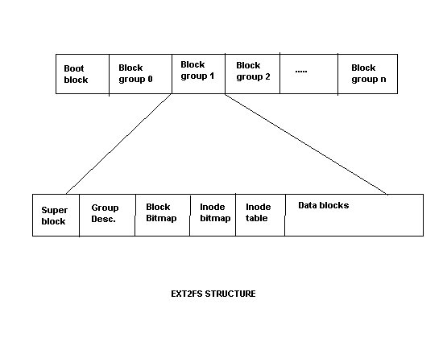
EXT2 File System
Originally used MINIX file system.Serious limitations like partition size,file name size etc.Proposed ext file system which was even worse.Led to excessive fragmentation.Remy Card et’al propose ext2fs which is the Unix file system.
Influenced by BSD FFS.Every partition is divided into a number of block groups,corresponding to the cylinder groups of FFS,with each block group holding a copy of superblock,inode and data blocks.

Slide 38
STRUCTURE OF E2FS
ext2 = Second Extended File System, a classic Linux file system.
It replaced the older MINIX and ext file systems, which had size and performance limits.
Still used today in some cases, and its design influenced ext3 and ext4.
Instead of keeping all inodes in one big table and all data blocks in another far away, ext2 divides the disk into block groups.
Why?
Keeps related data close together → reduces disk head movement → faster.
Balances file placement to avoid fragmentation.
Each block group contains:
Superblock copy (for backup)
Block group descriptor (info about this group)
Block bitmap → Tracks free/used data blocks
Inode bitmap → Tracks free/used inodes
Inode table → Metadata for files in this group
Data blocks → The actual file contents
Notes:
‹#›
Keep data blocks close to inode,file inodes close to directory inode.

Slide 39
Directories in ext2
In ext2, a directory is just a special file.
Instead of storing text or images, its data blocks contain a list of directory entries.
2. Directory Entry Structure
Each directory entry has:
struct ext2_dir_entry {
unsigned long inode; // Inode number of the file
unsigned short rec_len; // Size of this directory entry
unsigned short name_len; // Length of the file name
char name[EXT2_NAME_LEN]; // The file name itself
};
inode → Points to the file’s metadata
rec_len → Lets the OS know where the next entry starts
name_len → Length of the file name
name → Actual file name

Slide 40
Directories in e2fs
What happens on a delete?
ext2 doesn’t shuffle entries around when you delete a file.
Instead:
The inode number is set to 0.
The previous entry’s rec_len is updated to cover the empty space.
Why?
Avoids unnecessary moving of data.
The space can be reused later.
Notes:
‹#›
Don’t push/move the buffers around.Just change the value of the previous entry’s reclen to include this entry as well.Zero the inode number also.It can be reclaimed easily as well.

Slide 41
Block allocation in e2fs
What is Block Allocation?
When you create or grow a file, the file system must decide which disk blocks to use to store the file’s data.
Good allocation = faster file access, less fragmentation.
ext2’s Allocation Goals
Prevent fragmentation (scattering file pieces all over the disk).
Keep related data close together for speed.
Target-Oriented Allocation
When ext2 needs a block:
First → Look for free space right next to the last block of the file.
If not available → Look for a free block within 32 blocks of the last one.
If still not found → Use a free block in the same block group.
As a last resort → Allocate from another block group.
Notes:
‹#›
Don’t push/move the buffers around.Just change the value of the previous entry’s reclen to include this entry as well.Zero the inode number also.It can be reclaimed easily as well.

Slide 42
Pre-allocation (Clustering)
When ext2 allocates a block, it can reserve up to 8 following blocks if they’re free.
If the file is closed before all reserved blocks are used → the extra blocks are released.
This improves performance for sequential writes.
How ext2 Decides the Target Block
Let:
n = logical block number needed
l = last allocated block number
Target = l + 1 (next block in sequence) if possible.
Visualization
File: report.txt
Allocated: [Block 10][Block 11][Block 12][Block 13]
Instead of: [Block 10] [Block 200] [Block 57] [Block 999]

Slide 43
Thank you

